Slide 1




Data Visualization

Slide 2
Syllabus Theory : Module 1
Introduction to Data Visualization, Importance, applications, and tools, Visual Perception and Cognitive Load, Principles of Good Visualization, Clarity, accuracy, and aesthetics: Choosing the right chart for the data, Chart Types and Use Cases, Bar, Line, Pie, Scatter, Histogram, Boxplot, Heatmap, Bubble, Area charts etc. Advanced Visualization Techniques: Interactive Plots with Plotly and Bokeh, Advanced Seaborn Techniques, Pairplots, Cat Plots, FacetGrid, and Heatmaps, Dashboards with Plotly Dash / Streamlit, Visualizing Multidimensional and Time Series Data, Geo-visualization with Folium and Plotly. Business Analytics, Health Informatics, AI/ML Model Interpretability (SHAP, Partial Dependence), Ethical and Cultural Aspects of Visualization. Assignments & Activities: Create visualizations for a given dataset using Matplotlib and Seaborn, Analyze misleading visualizations and redesign them; mini-project: Storytelling with a dataset (e.g., COVID-19, Olympics, GDP)

Slide 3
Syllabus Theory : Module 2
Introduction to Business Intelligence (BI). Overview of Power BI and Tableau, Installation and Interface Tour, Connecting to Data Sources, Importing data (Excel, CSV, SQL Server, Web), Data types and formats, Live vs Extract connections (Tableau), Direct Query vs Import (Power BI), Power Query Editor (Power BI), Data Interpreter & Data Prep (Tableau), Cleaning, filtering, pivoting/unpivoting, Merging and appending data sources, Understanding tables and relationships, Creating calculated columns, measures, Introduction to DAX (Power BI), Introduction to Tableau Calculated Fields,Creating core charts: Bar, Line, Pie, Scatter, Maps, Filters, slicers, and drill-down (Power BI), Quick filters, parameters, sets, groups (Tableau) Tooltips, color, size, labels, and hierarchies, Dashboards and Storytelling using PowerBI and Tableau, Designing dashboards and layouts, Using tiles, containers, and formatting, Actions and Interactivity (filters, URL, highlights), Dashboard best practices and storytelling with data. Publishing reports to Power BI Service, Tableau Public and Tableau Server, Exporting dashboards as PDF/images, Scheduled refresh and data update. Activities:Build an interactive dashboard for a public dataset; Capstone Project: Data story + dashboard on a chosen theme, Peer review and presentation sessions. Dashboard themes: Business Analytics Dashboard, Sales/Marketing Dashboard, Healthcare/COVID Dashboard, Education or HR Analytics Dashboard.

Slide 4
Syllabus: LAB
• Getting Started with Power BI/Tableau. Import a simple CSV dataset (e.g., Superstore, Iris) and explore basic views: table, bar, and line charts. • Data Cleaning and Transformation. Use Power Query (Power BI) or Data Interpreter (Tableau) to clean missing values, rename columns, change data types, and create calculated fields. • Creating Bar and Line Charts for series data. Use sales or stock market datasets to create bar charts for categories and line charts for trends over time. Add tooltips and labels. • Interactive Dashboards with Filters and Slicers. Build a dashboard for a retail dataset that includes filters for region, category, and date. Use slicers (Power BI) or filter actions (Tableau). • Geo-Visualization with Maps. Use a dataset with location data (e.g., country/state/city-wise sales or COVID-19 cases) and create a filled map or symbol map. • Pie and Donut Charts for Category Proportion. Use a dataset like the Olympic medals dataset to show proportions using pie and donut charts. Analyze medal share by country.

Slide 5
Syllabus: LAB
• Creating KPI Cards and Custom Metrics. Create KPIs such as Total Sales, Profit Margin, and Growth Rate using DAX (Power BI) or Calculated Fields (Tableau). Display as cards. • Heatmaps and Tree Maps. Create heatmaps for correlation matrices and tree maps for category-wise sales in a multilevel category dataset (e.g., Category > Subcategory). • Time Series Forecasting and Trend Lines. Use a stock price or sales dataset to add trend lines, moving averages, and forecasts. Explore Tableau forecast model or Power BI's analytics panel. • Capstone: Storytelling with Dashboards. Choose a theme (e.g., GDP growth, education statistics, environmental data), prepare and clean the data, and build an interactive dashboard that tells a compelling story using both Tableau and Power BI. Present findings.

Slide 6
Lecture 1: Introduction to Data Visualization

Slide 7

Agenda
What is Data Visualization
Importance of Data Visualization
Applications of Data Visualization
Tools for Data Visualization
Data Visualization Process
Job Opportunities and Roles
Top Recruiters
Case Studies
Quiz

Slide 8

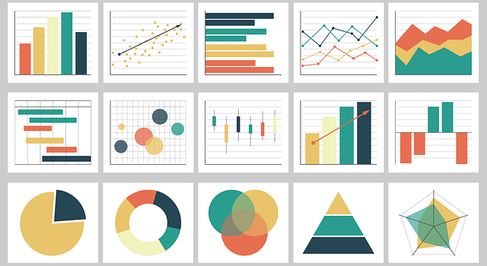
What is Data Visualization
Data visualization is the graphical/Pictorial representation of information and data. By using visual elements like charts, graphs, and maps, it provides an accessible way to see and understand hidden insights trends, outliers, and patterns in data.
Data Visualization Helps Business for better Decision Making
Finding Solutions to Problems
Helps Data Scientists to build and analyze machine learning models

Slide 9


Who is better batsman ?

Slide 10


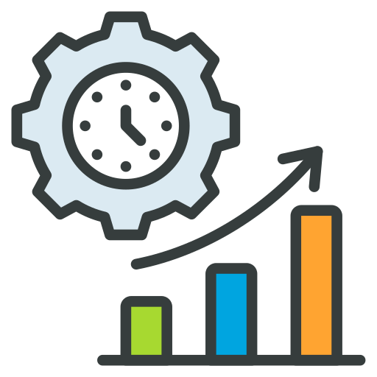
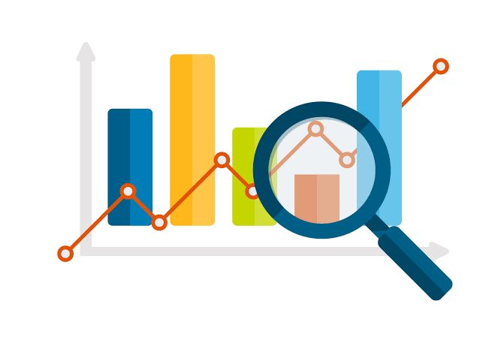
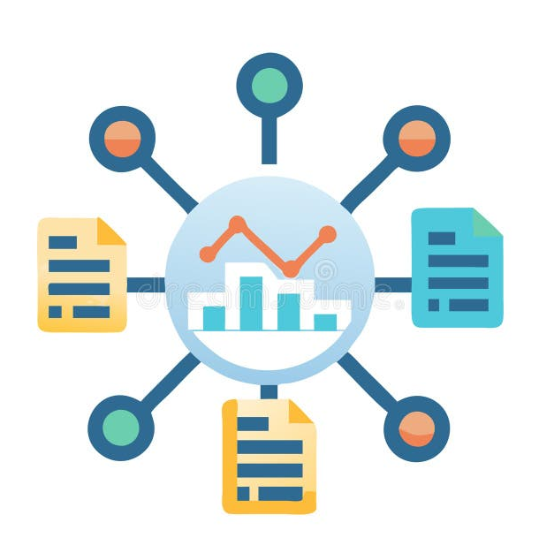

Importance of Data Visualization
Enhances Understanding and Interpretation
Improve Decision-Making
Identifies Trends and Patterns
Increases Efficiency
Supports Big Data Analysis
Helps in Data Storytelling

Slide 11

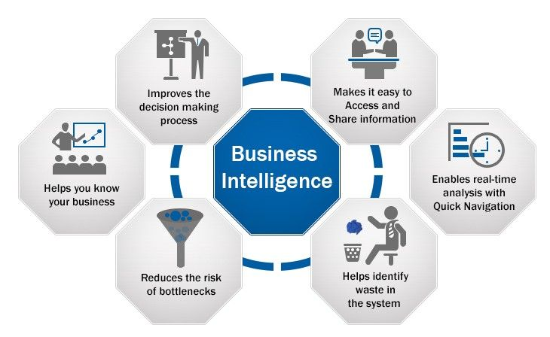
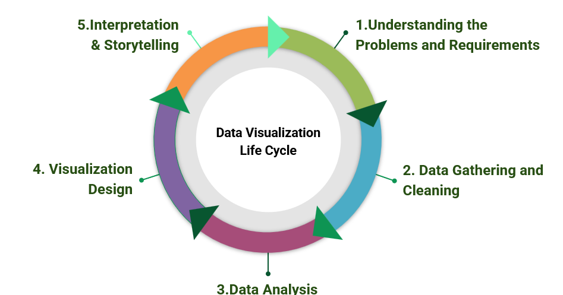
Data Visualization
Business Intelligence

Slide 12
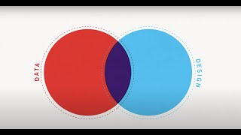
Importance of Data Visualization

Slide 13
Importance of Data Visualization
Region | Product | Jan Sales | Feb Sales | Mar Sales | Apr Sales | May Sales | Jun Sales
North | A | 1230 | 1295 | 1100 | 1400 | 1320 | 1150
North | B | 980 | 1020 | 960 | 1080 | 1015 | 995
East | A | 1125 | 1170 | 1135 | 1190 | 1185 | 1160
East | B | 870 | 895 | 900 | 920 | 880 | 915
South | A | 1430 | 1380 | 1475 | 1500 | 1480 | 1460
South | B | 1020 | 1090 | 980 | 1050 | 1005 | 990
West | A | 1300 | 1325 | 1280 | 1360 | 1340 | 1310
West | B | 960 | 940 | 930 | 950 | 970 | 965
1.Which region performed best in total sales?
2.Which product is more successful overall?
3.When were the sales weakest?

Slide 14
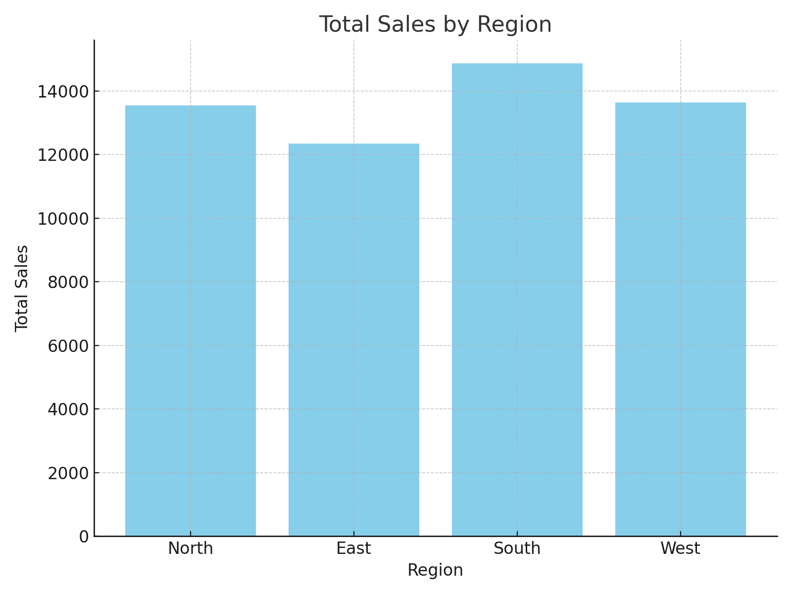
Importance of Data Visualization
South performed best in total sales.

Slide 15
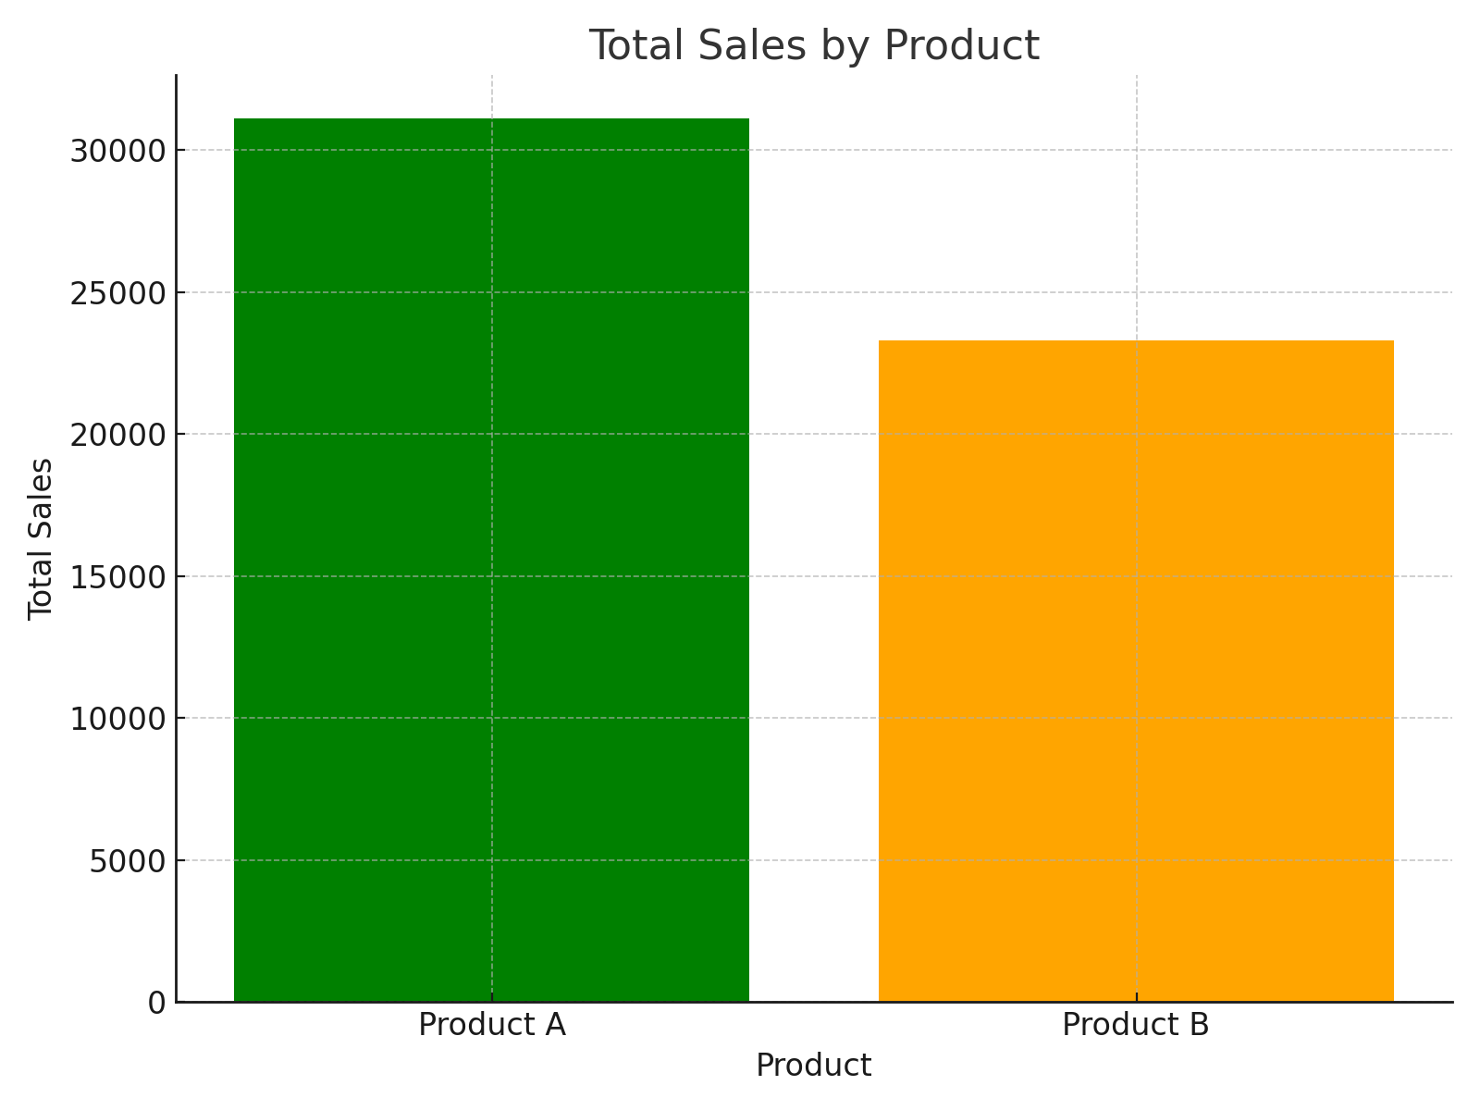
Importance of Data Visualization
Product A is more successful overall.

Slide 16
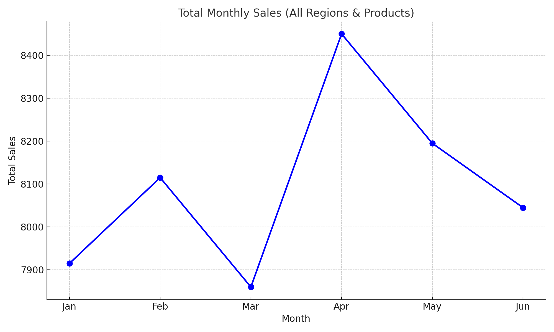
Importance of Data Visualization
March was the weakest month for sales.

Slide 17


THE MAP THAT SAVED A CITY
A STORY OF DEATH, DATA, AND DISCOVERY IN 1854 LONDON

Slide 18

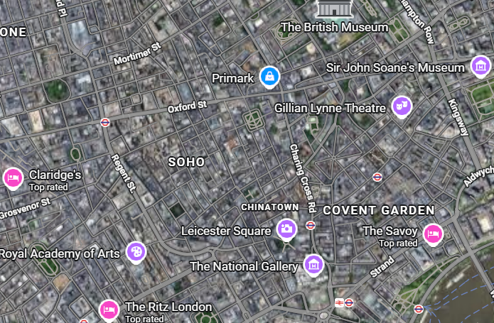
LONDON, 1854: A DEADLY SUMMER BEGINS
A strange and sudden outbreak is sweeping through Soho.
Dozens of people dying every day.
Panic spreads. The cause is unknown.

Slide 19

THEORIES IN SOHO
The air smells foul. People blame 'bad air' (Miasma).
Others think it's divine punishment or moral decay.
Science has no answers. Fear takes over.

Slide 20

ONE MAN STEPS IN
Dr. John Snow, a physician, is skeptical of popular theories.
He starts asking: 'Where are people dying?'
Begins collecting location data on deaths.

Slide 21
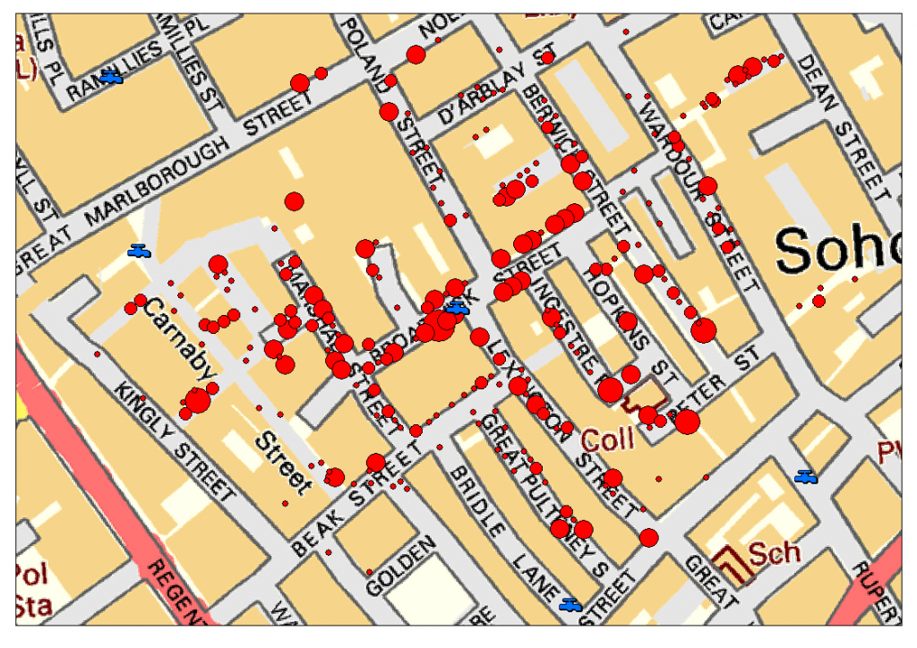
DATA COLLECTION BEGINS
Snow plots each death on a city map.
Each death is represented by a small circle.
Over time, a visual pattern starts to form.

Slide 22

A CLUSTER APPEARS
The dots begin to cluster around Broad Street.
Other areas of the city are largely unaffected.
The question emerges: 'What is unique about this
location?'

Slide 23

WHAT WAS THERE?
Snow adds locations of public water pumps to his map.
A chilling discovery: The highest death count surrounds
the Broad Street pump.
Could the pump be the source?

Slide 24

THE INVISIBLE KILLER WAS… CHOLERA
Cholera, a waterborne disease, was spreading through the pump.
The cause wasn't the air, but contaminated water.
The mystery is solved with simple mapping.

Slide 25
WHEN MAPS SAVE LIVES
John Snow's map wasn’t just data – it was insight.
A visualization that reshaped modern epidemiology.
The first data-driven intervention in medical history.

Slide 26

Application
Finance:
Market Trends
Tracking stock performance
Managing risk.
Identify potential investment opportunities.

Slide 27
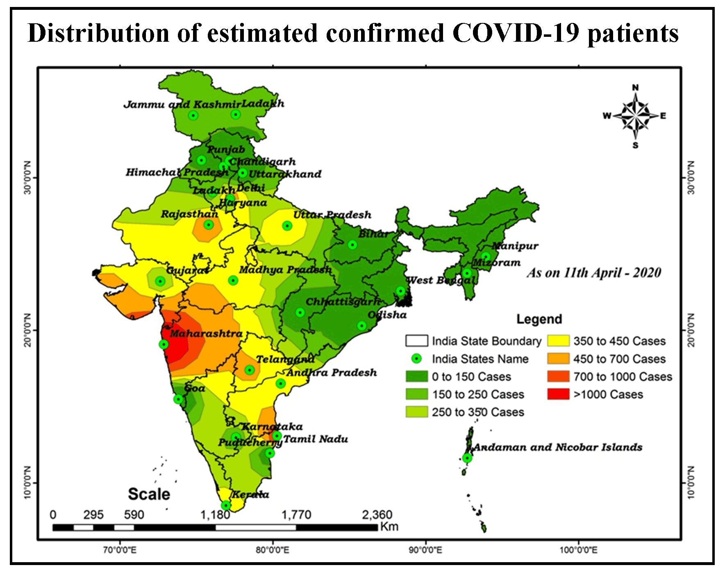
Application
Healthcare :
Tracking patient data
disease trends
hospital performance.
For example, visualizing the spread of an infectious disease can help healthcare professionals allocate resources effectively.

Slide 28

Application
Marketing:
Allowing businesses to understand customer behavior,
Track sales trends
Analyze marketing campaign performance.
Optimizing marketing strategies and
Improving ROI.

Slide 29
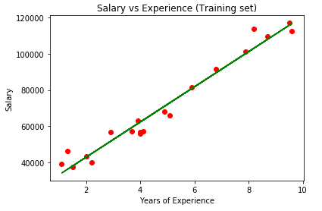
Application
Data Science:
Exploratory data analysis (EDA).
Shows relationships between variables.
Compares model performance using graphs such as ROC curves, confusion matrices, and residual plots.
Helps identify overfitting or underfitting.
Explore and understand complex datasets.
Identify patterns.
Visualize predictive models.

Slide 30
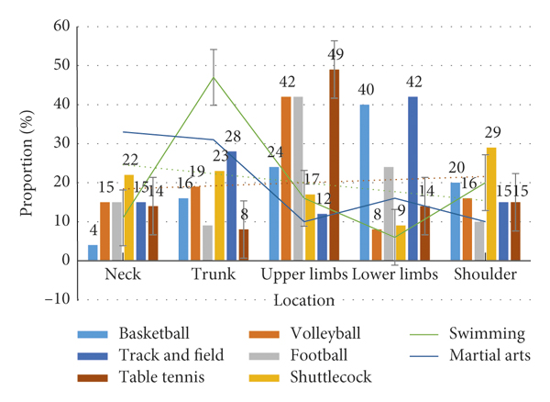
Application
Other Applications:
Education,
Scientific research,
Sports analytics to gain insights from data and improve performance.

Slide 31

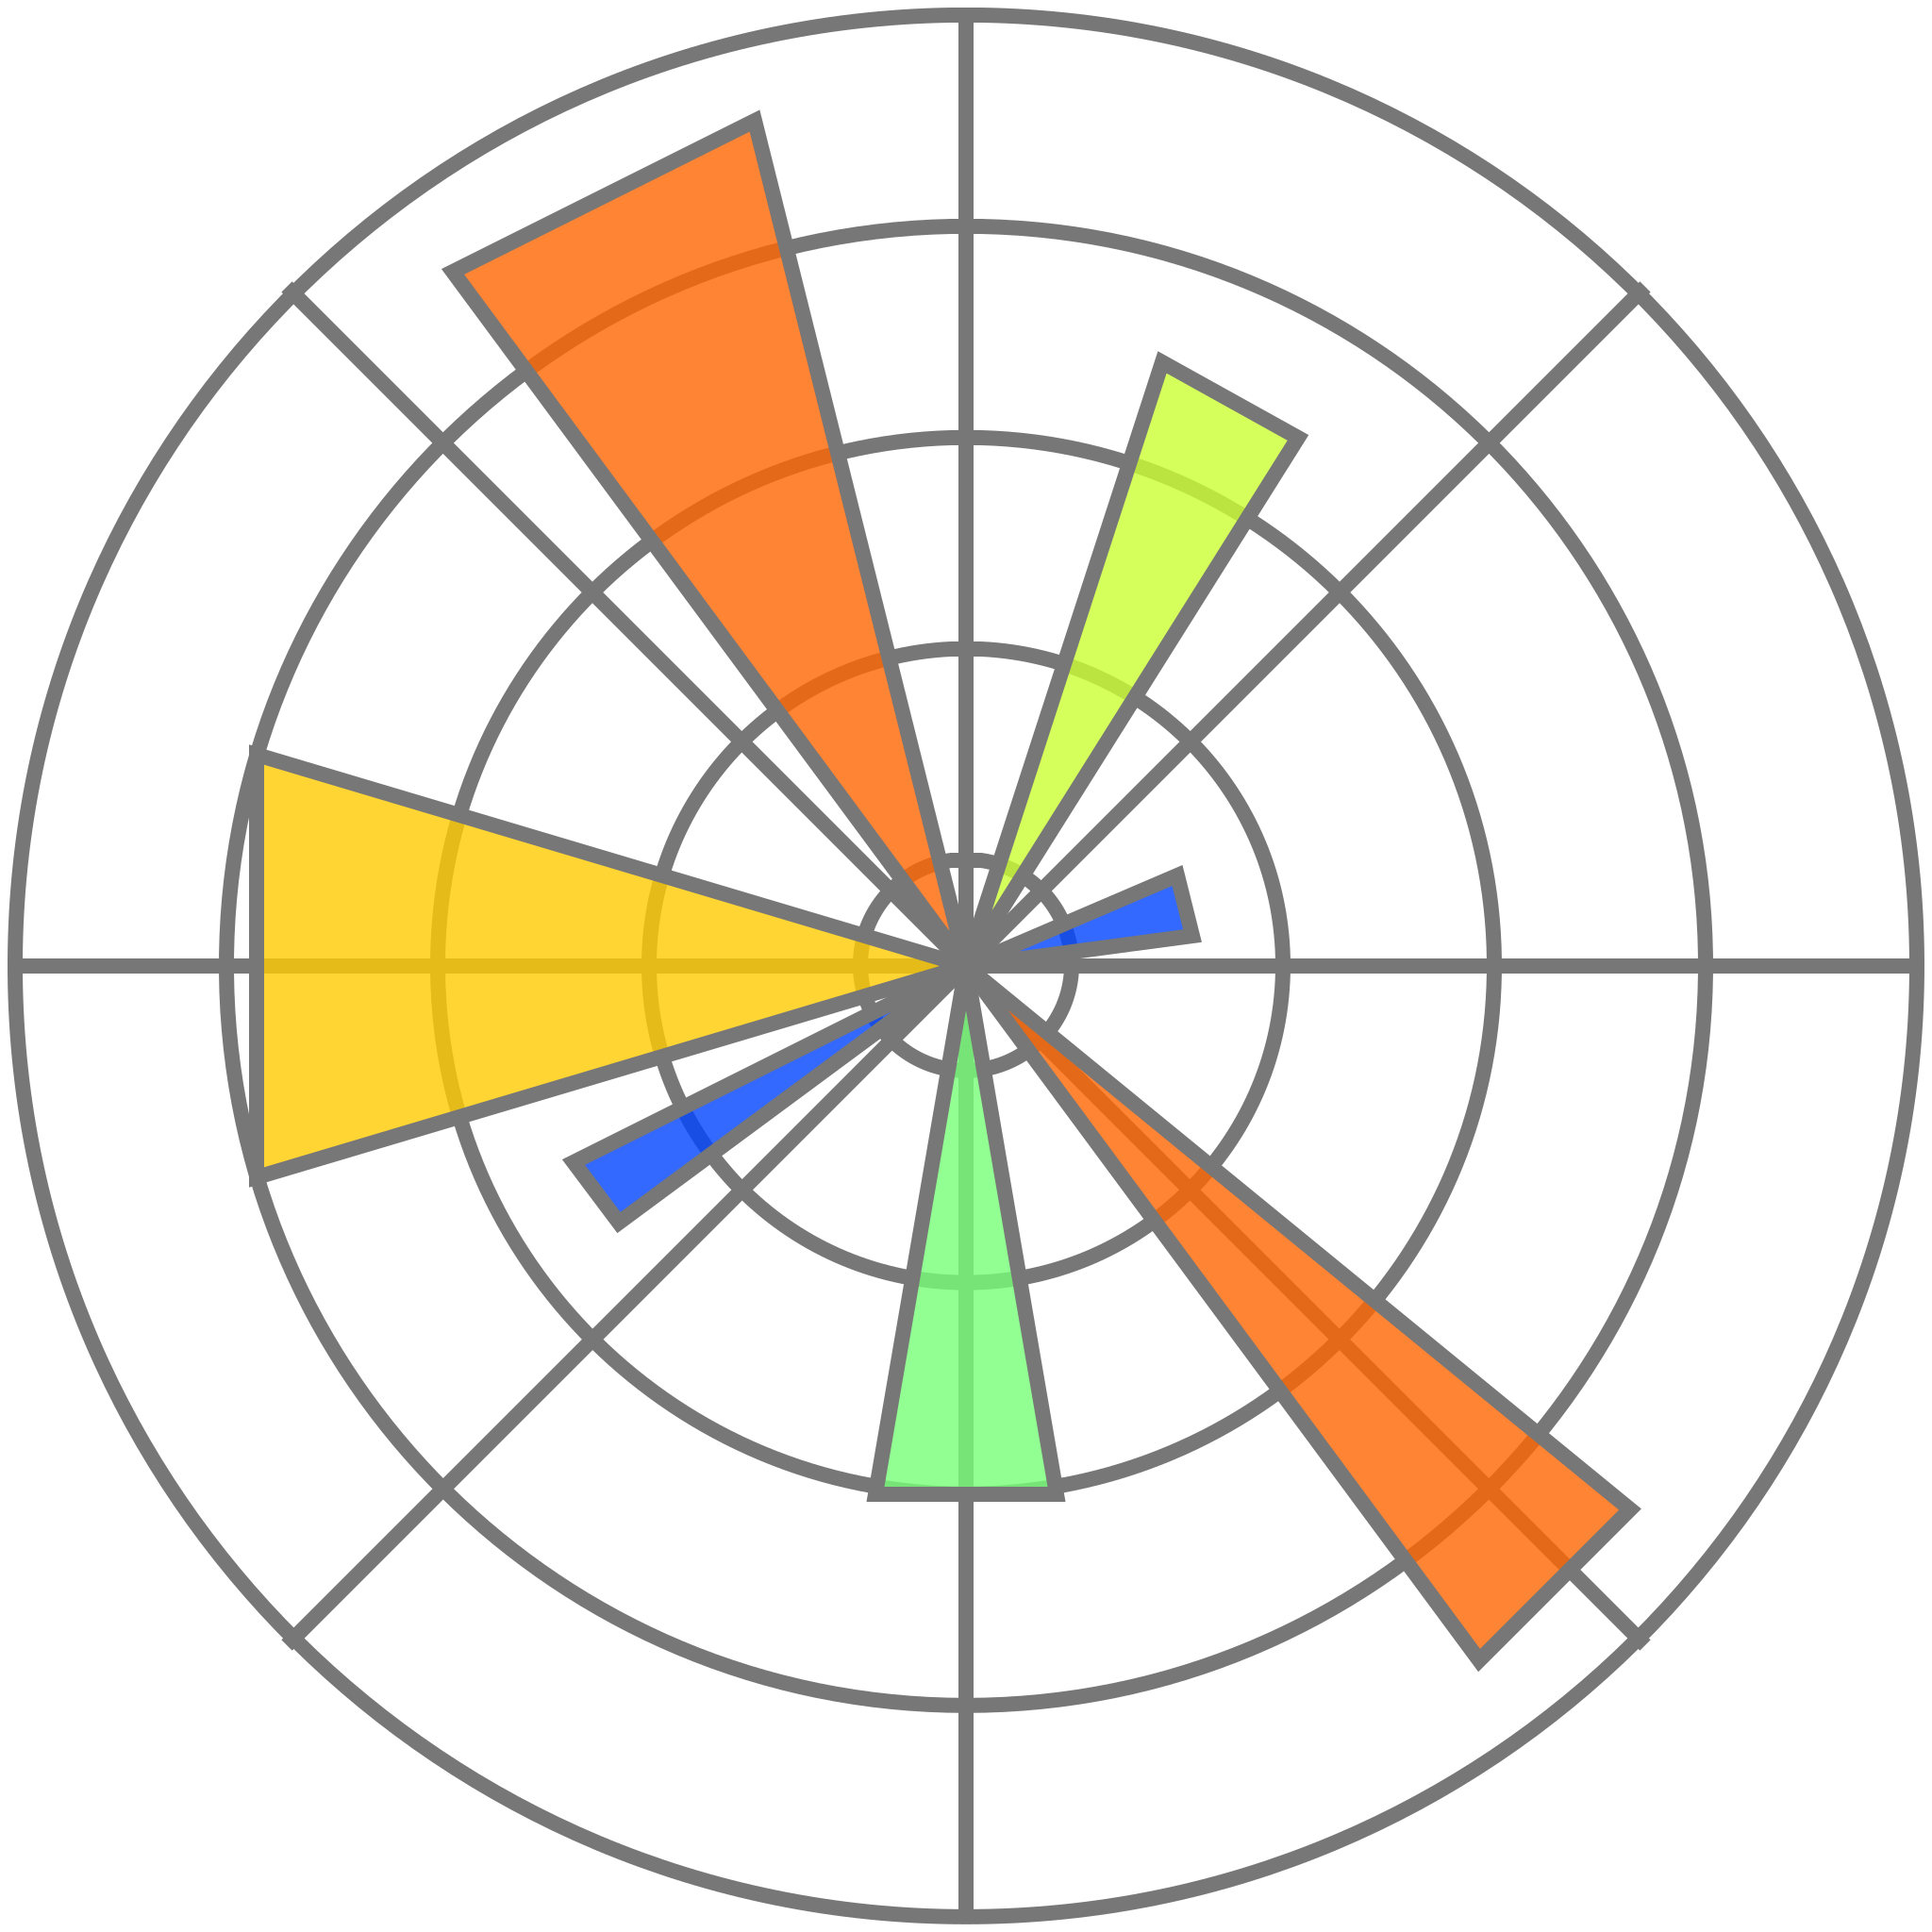







Tools For Data
Visualization
Tool | Language | Feature
Matplotlib | Python | Highly customizable static plots; ideal for detailed control.
Seaborn | Python | Built on Matplotlib; easier syntax for statistical plots.
Plotly | Python, R, JavaScript | Interactive charts; supports dashboards.
Bokeh | Python | Interactive visualizations for web browsers.
ggplot2 | R | Grammar-of-graphics-based plotting; very popular in R.
D3.js | JavaScript | Powerful library for creating interactive, web-based visualizations.
Altair | Python | Declarative statistical visualization; integrates well with Pandas.
Chart.js | JavaScript | Simple, responsive charts for websites.
Code-Based Tools (for developers, analysts, data scientists)

Slide 32








Tools For Data
Visualization
Tool | Key Features
Tableau | Industry standard; drag-and-drop interface; powerful dashboards.
Power BI | Microsoft ecosystem; strong Excel integration; real-time analytics.
Google Data Studio (Looker Studio) | Free; great for Google Analytics & Ads data.
Qlik Sense | Associative data model; good for self-service BI.
Zoho Analytics | Affordable; good for SMBs; built-in AI insights.
Microsoft Excel | Still widely used; basic but effective charts and pivot tables.
Grafana | Ideal for time-series data and system monitoring.
Metabase | Open-source BI tool; easy SQL + dashboard creation.
No-Code / Low-Code Tools (for business users, analysts)

Slide 33
Data Visualization Life Cycle
5.Interpretation & Storytelling
1.Understanding the Problems and Requirements
Data Visualization Life Cycle
4. Visualization Design
2. Data Gathering and Cleaning
3.Data Analysis

Slide 34
Job Opportunities
1. Data Visualization Specialist
What they do: Design charts, dashboards, and visuals from complex data.
Tools: Tableau, Power BI, D3.js, Plotly, Looker, Adobe Illustrator (for static infographics).
Skills: Data storytelling, visual perception, tool expertise.
2. Data Analyst
What they do: Analyze data and present findings via visual reports.
Tools: Excel, Tableau, Power BI, Python (Seaborn, Matplotlib).
Skills: Data querying, EDA, dashboard design, stakeholder communication.
3. BI (Business Intelligence) Developer
What they do: Build and maintain interactive dashboards and reports for decision-making.
Tools: Tableau, Power BI, Looker, Qlik, SQL.
Skills: Data modeling, SQL, KPI tracking, user experience.

Slide 35
Companies
Company | Main BI Tools
Accenture | Power BI, Tableau, SQL
Tata Consultancy Services (TCS) | Power BI, Tableau, Qlik
Infosys | Power BI, SQL, Azure
Wipro | Tableau, Power BI
Cognizant | Tableau, Power BI
Capgemini | Power BI, SQL
HCLTech | Power BI, Tableau
Tech Mahindra | Power BI, Excel

Slide 36
Florence Nightingale – Death Chart
Crimean War Hospital Reforms

Slide 37
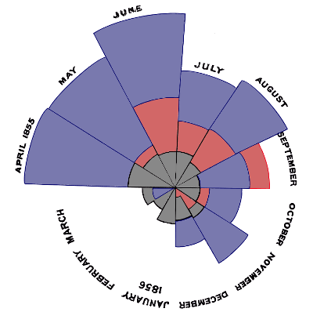
Problem: High mortality in war hospitals.
Action: Data collection and visual storytelling via rose diagrams.

Slide 38

Mortality dropped from 42% to 2%
birth of modern nursing and statistical health reform

Slide 39



